Slide 1



Engineering a better future.
Empowering Performance
Unleashing the Potential of Open-Source Tools for Hybrid Performance Testing
Enes Kühn, QA Solution Architect HTEC group Sarajevo, Bosnia and Herzegovina

Slide 2

What is performance testing?
Performance testing is a type of nonfunctional software testing that evaluates the performance of a system under various conditions, including high load, stress, and scalability.
The goal of performance testing is to identify bottlenecks, determine the responsiveness, stability, scalability, and resource usage of the system, and to ensure that it can meet its performance requirements under various conditions.
Engineering a better future.

Slide 3
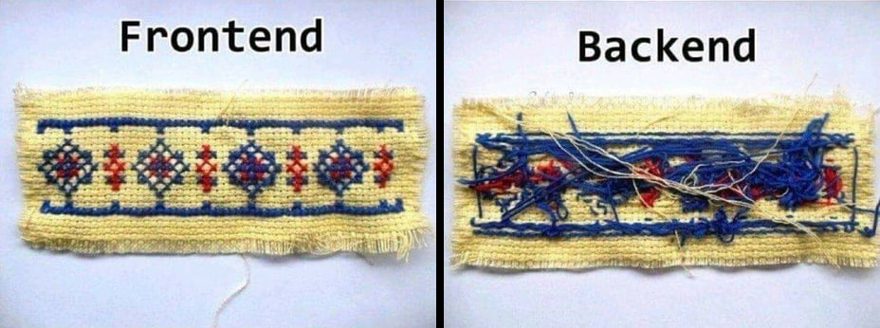
Aspects of performance testing
there are many aspects of performance testing bit generally, from the hybrid testing standpoint, we can divide it into two main categories:
performance testing
performance testing
Engineering a better future.

Slide 4
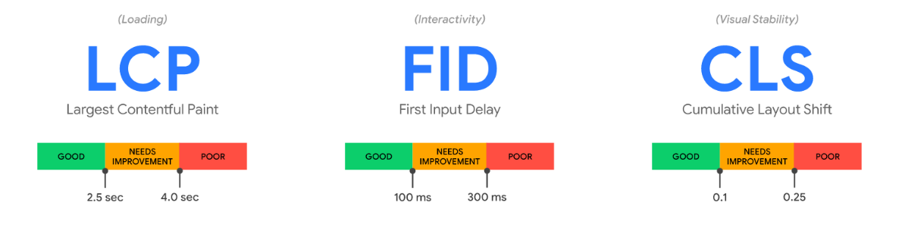
Frontend performance testing
Frontend performance testing is a type of performance testing that focuses specifically on the performance of the frontend or user interface of a web application. It involves measuring the speed and responsiveness of the user interface and how quickly it loads and displays content for the user.
Core Web Vitals
Core Web Vitals are the subset of Web Vitals that apply to all web pages, should be measured by all site owners, and will be surfaced across all Google tools. Each of the Core Web Vitals represents a distinct facet of the user experience, is measurable in the field, and reflects the real-world experience of a critical user-centric outcome.
Engineering a better future.

Slide 5

Frontend performance testing – Core Web Vitals
browser_web_vital_lcp: Largest Contentful Paint - metric reports the render time of the largest image or text block visible within the viewport, relative to when the page first started loading. (good < 2.5 sec)
browser_web_vital_fid: First Input Delay - measures the time from when a user first interacts with a page (that is, when they click a link or clicks on a button) to the time when the browser is able to begin processing event handlers in response to that interaction. (good < 100 ms)
browser_web_vital_cls: Cumulative Layout Shift - is a measure of how much a webpage unexpectedly shifts during its life. For example, if a website visitor loaded a page and, while they were reading it, a banner loads and the page jumps down, that would constitute a large CLS score.
layout shift score = impact fraction x distance fraction
Impact fraction relates to the size of the unstable element in comparison to the viewport.
Distance fraction is the amount the unstable element moves as a ratio of the viewport.
(good < 0.1)
Engineering a better future.

Slide 6

Frontend performance testing is realistic!
Engineering a better future.

Slide 7
Backend performance testing
Backend performance testing is a type of performance testing that focuses on evaluating the performance of the backend infrastructure and components of a system. This includes measuring the performance of the application server, database server, APIs, and other backend components that are critical to the functionality of the system.
http_reqs: How many total HTTP requests is generated.
http_req_blocked: Time spent blocked (waiting for a free TCP connection slot) before initiating the request.
http_req_connecting: Time spent establishing TCP connection to the remote host.
http_req_receiving: Time spent receiving response data from the remote host.
http_req_duration: Total time for the request (send + wait + receiving).
http_req_failed: The rate of failed requests.
Backend performance testing typically involves measuring a number of key performance metrics, including:
Engineering a better future.

Slide 8

Engineering a better future.

Slide 9

Load testing
Load testing is a type of performance testing that involves subjecting a system or application to a high workload or load to measure its performance under heavy usage.
The goal of load testing is to identify the system's maximum capacity, how it responds to different levels of stress, and to find and eliminate performance bottlenecks before the system is deployed in a production environment.
Engineering a better future.

Slide 10

Load testing is expensive?!
Especially frontend testing
Tool dependent (price plans)
Environment scalability costs
Production-like environment
Or not?
Engineering a better future.

Slide 11



k6.io
Engineering a better future.

Slide 12
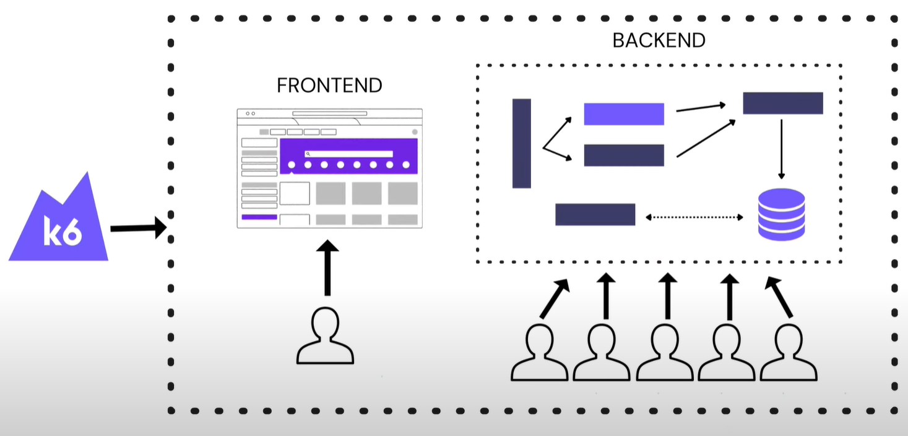

Hybrid load/performance testing
k6 API + k6-browser
Engineering a better future.

Slide 13

Engineering a better future.
https://github.com/eneskuehn/TestersDay2023

Slide 14
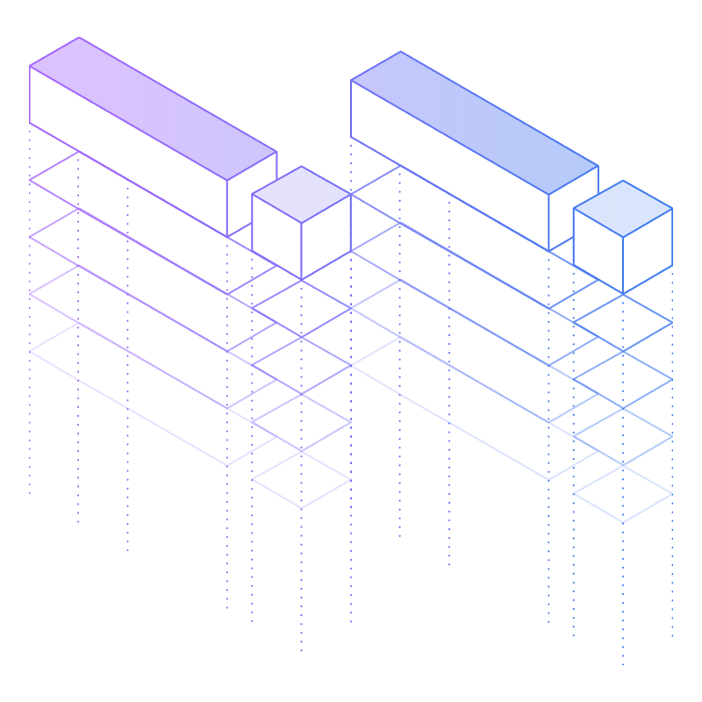
WARNING!!!
Do not use commercial sites while studying
Engineering a better future.

Slide 15
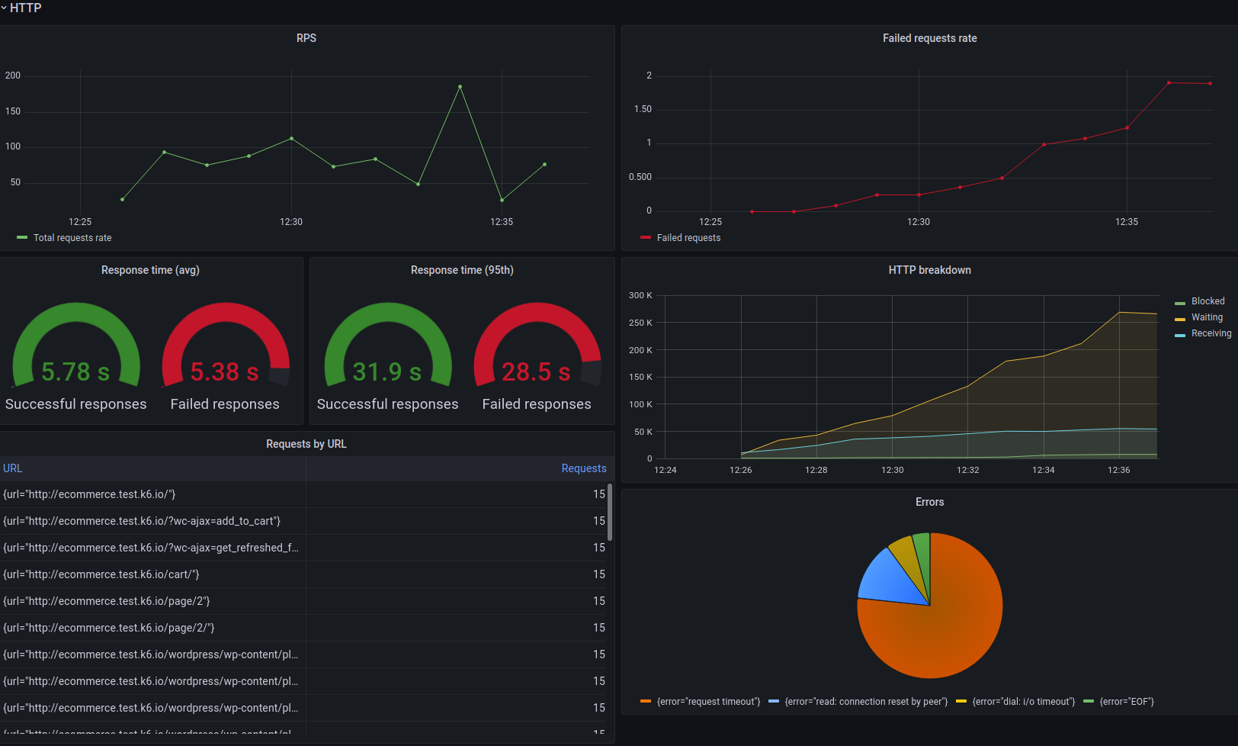
What’s next?
- Grafana Cloud k6
Engineering a better future.

Slide 16

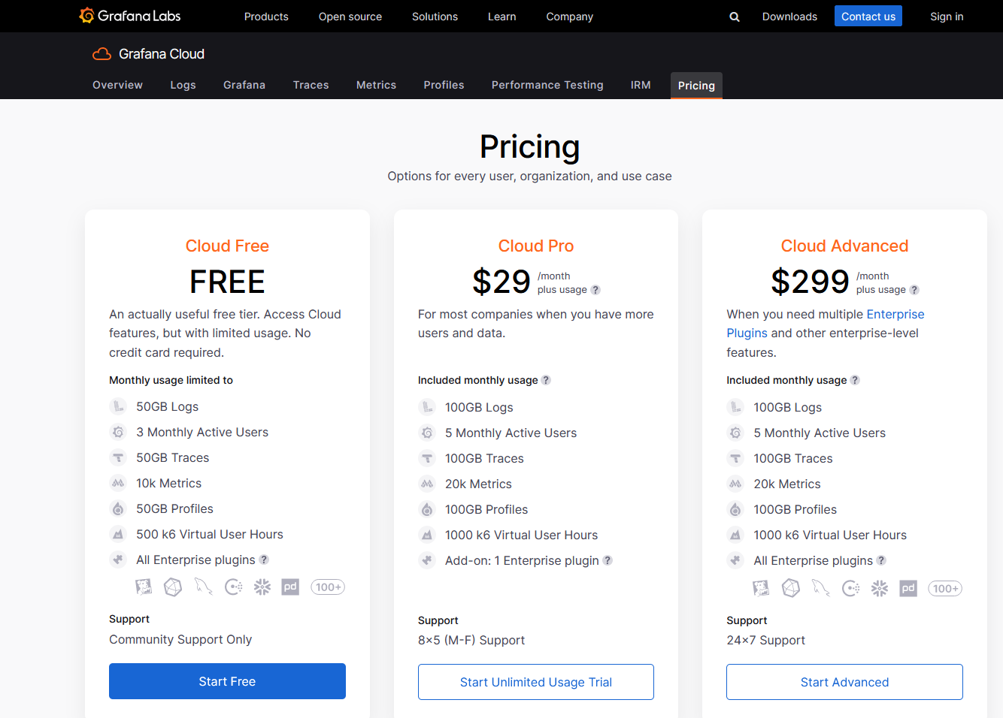

NOTE: Don’t get fooled by pricing. k6 API & k6-browser are FREE
On-Prem hybrid testing
Engineering a better future.

Slide 17



Contact
Enes Kühn
QA Solution Architect
linkedin.com/in/eneskuhn
enes.kuhn@htecgroup.com

